Slide 1
Ele00118m practical robotics
Yusheng Zhang
Exam Number: Y3915588
Department of electronics
University of York

Slide 2
Analyze-prerequisite
The car can run
The car need know its speed for rotating angle
The car can avoid obstacles
The arena must have some attributes can be used by car to find the goal

Slide 3
Analyze-ACHIEVE THE GOAL
Following the priority sequence of the color
Following the priority sequence of the ID
Following the fixed rules(deprecate, low applicability in different maps)
SLAM + LIDAR + ROS (hard)

Slide 4
Core ISSUES
Avoid obstacles
ID priority sequence
Color priority sequence
Mapping
Find shortest path
Running on the shortest path

Slide 5
Core ISSUES - solution
Avoid obstacles (p controller + solve rotate angles to time problem)
ID priority sequence (sequence stack / queue)
Color priority sequence
Mapping (lidar with 360 data)
Find shortest path (Dijkstra / A*/ BFS / DFS)
Running on the shortest path (running on occupancy grid)

Slide 6
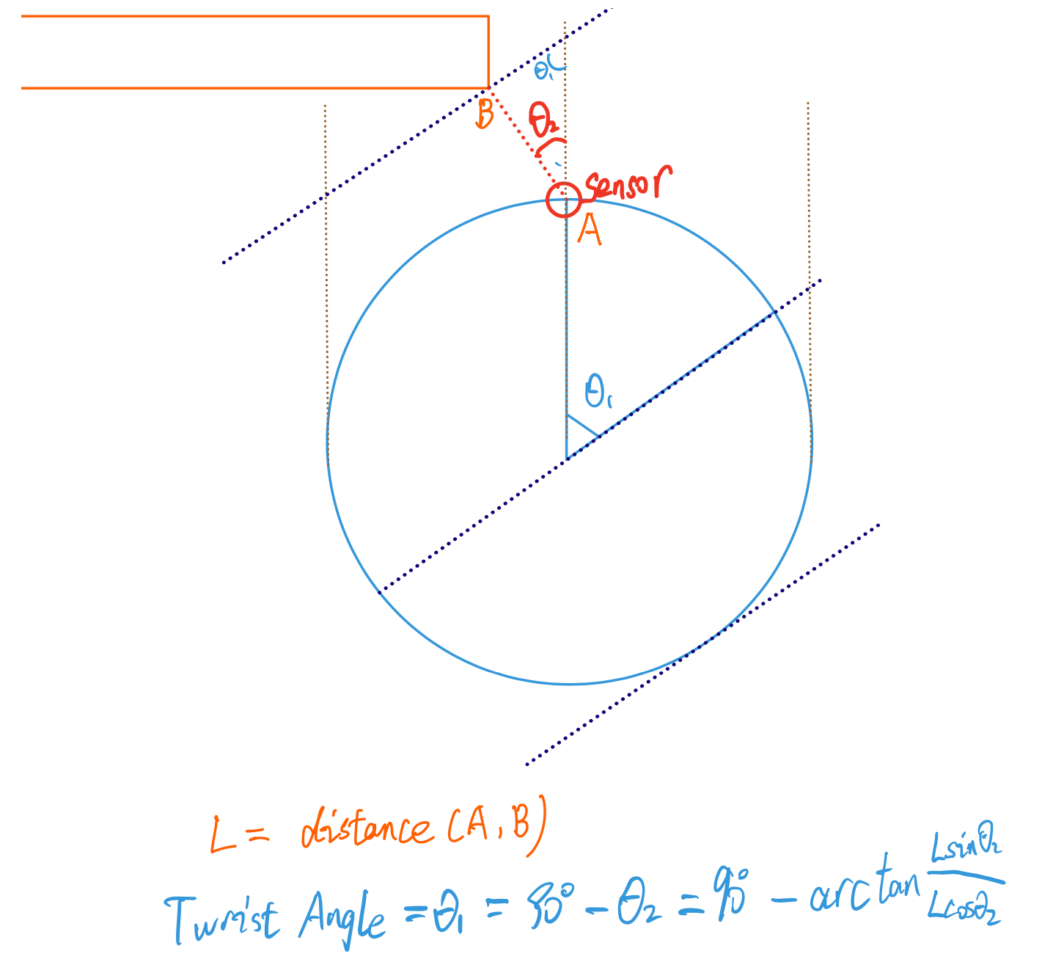
Core problems - avoid obstacles
velocity(calc from motor encoder)
+ Radius
—>
Angle speed(W)
—>
Rotate Anlgle

Slide 7
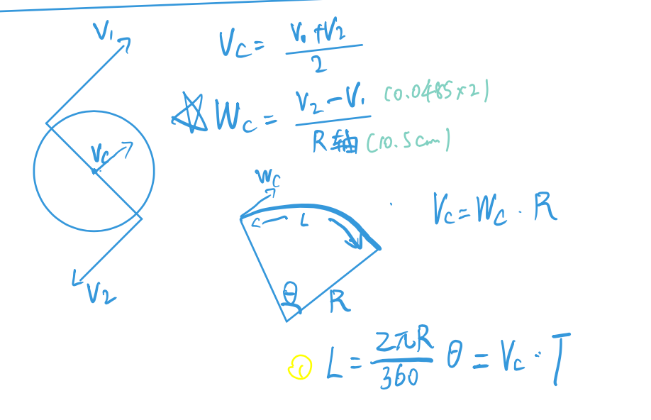
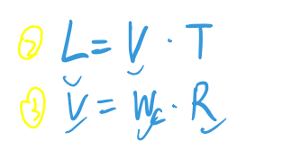
Core problems - avoid obstacles

Slide 8
Exception1 car struck at angle
- algorithm
Get the surrounding distances data
In a threshold time(for example: 5s), judge if distances changed or not
If not changed, retreat and turn right/left to avoid stuck

Slide 9
Exception2 car struck(repetitive turn left and right forever)
- algorithm
Set a threshold X
If turned left and then turned right, X += 1
If X exceed the threshold, then force turn right/left Y times to avoid stuck

Slide 10
TIPS
ASYNC running all sensors in threads
Using global wheels’ velocity to control the motion of the car

Slide 11
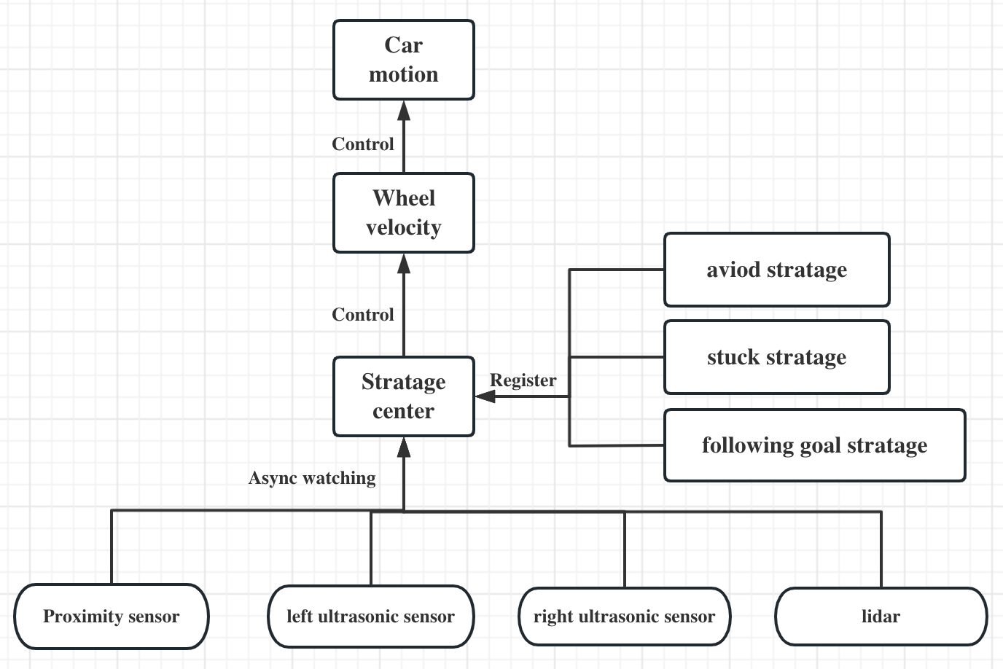
Software Architecture

